Slide 1

Big Mountain Resort
Lift ticket price analysis

Slide 2
Problem Statement
What lift ticket price for Big Mountain Resort will result in 10% growth of the bottom line in FY2021, to be determined by considering which existing features can be better leveraged for higher Revenues, which can be discontinued for lower costs, and which potential new features could create a positive return on investment.
H
1
Context
4
Constraints within solution space
To this point, Big Mountain Resort has based its lift ticket prices by simply adding a modest premium to the average price at nearby resorts. There is a suspicion that this strategy is leaving money on the table by under-leveraging existing facilities and missing opportunities to lower costs.
One constraint present in this project is related to scope. If lift ticket price is correlated to resort features or intangibles not present in the data (e.g. service levels, room quality, other resort amenities, etc.), there is a risk of misidentifying the ideal price that will actually be borne by the market. The potential benefits likely outweigh this risk, however.
2
Criteria for success
5
Stakeholders to provide key insight
This project will be considered successful if statistical analysis can determine the collection of features that warrants a lift ticket price that maximizes potential revenue and minimizes cost.
Jimmy Blackburn - Director of Operations
Alesha Eisen - Database Manager
3
Scope of solution space
6
Key data sources
The scope of this project is limited only to features and facilities directly involved in the operation of the ski resort.
The data source for this project is a file provided by the database manager that contains feature and ticket price information for a large number of ski resorts in the United States.
H
D
E
I
P
Notes:
Hypothesis: Create a Hypothesis with an emphasis on SMART principles. (S – Specific, M – Measurable, A – Achievable, R – Realistic, T – Timebound). If you cannot do this, you do not have a good grasp on the business problem.
Context: With context, we have clearly identified the problem at hand and have elucidated on how our initiative may solve this problem, alongside the commercial implications this will have on the business.
Criteria for Success: Clearly defining the criteria for success ensures that the scope of your work is clearly defined and understood. Otherwise, if this isn’t defined – your work will never end which will result in mismatched expectations.
Scope of Solution Space: Scoping out the solution space ensures that the business initiative is SPECIFIC for a certain segment or area. This prevents solutions that have been developed being scaled and applied for all other business units that the solution may not be responsible or scalable for.
Constraints within Solution Space: Looking forward, what are the foreseeable problems we are likely to encounter? Could this be stakeholder resistance? Could this be we don’t have access to the right data?
Stakeholders to provide key insight: Who are the people I need to speak to, to get the answers I need for my data analysis?
What key data sources are required?
Based off my discussions with the key stakeholders – can we clearly list out all the data sources we need so we can make a highly targeted request as opposed to a scatter-gun approach where we ask for a bit of everything?

Slide 3
Results and Recommendations
Based on our analysis, the mix of features provided at Big Mountain Resort supports an increase in lift ticket price.
In addition, of the 4 scenarios proposed by management, two were shown to contribute to potential profits:
Scenario 1: Close the 4 least-used runs to reduce maintenance costs.
Scenario 2: Increase the vertical drop by adding a run to a point 150 feet lower down with the installation of a new chairlift to service it.
Scenario 3: Adding additional snow-making coverage to the new run created in Scenario 2.
Scenario 4: Increase the longest run by 0.2 mile to boast 3.5 miles length, requiring an additional snow making coverage of 4 acres
$81
$92

Slide 4
Source Data and Analysis Methodology
Source Data
330 Resorts around the United States
Descriptive information (e.g. Name, State, Region)
Numerical data (e.g. Vertical drop, # of runs, # of lifts)
Target variable: Adult Weekend Lift Ticket Price
Issues: Null-values in ticket price for 14% of resorts; records removed
Methodology
Primary goal: Create a machine learning model which can take a specific list of ski resort features highly correlated with ticket price and from it determine a ticket price prediction.
Some of the features found to correlate strongly with ticket price include:
Vertical Drop (ft.)
# of Runs
# of Chairs, # of FastQuads
Snowmaking Area (ac.)
# of Days Open

Slide 5
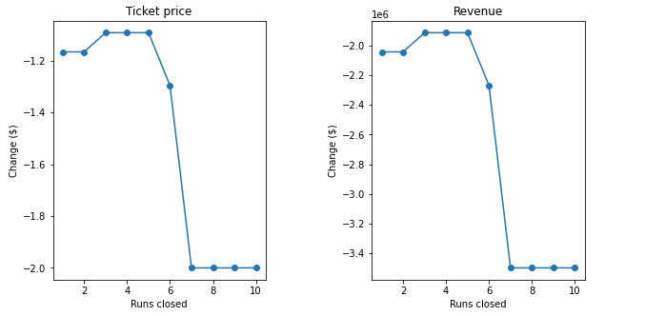
Current-State Ticket Price and Scenario 1
Results for Current-State Features
We created a Random Forest model that trained on 70% of the data and was tested on the remaining 30%. The Mean Average Error for this model was approximately $9.00.
When run on Big Mountain’s specific list of feature, our model predicted a ticket price of $92.39 vs. the actual current price of $81.
Scenario 1
While Scenario 1 initially proposed closing 10 runs, our model showed that closing more than 4 results in a precipitous drop in predicted ticket price and associated Revenue. As such, we only recommend closing the 4 least popular runs.

Slide 6
Scenarios 2 and 3
Scenario 2
Increase the vertical drop by adding a run to a point 150 feet lower down with the installation of a new chairlift to service it.
Model-predicted impact on Ticket Price = +$1.31 per Ticket
Using avg. of 5 days per customer = +~$2.3M additional Revenue/Yr.
Estimated install + maintenance costs = ~$1.5M -> Positive ROI
Scenario 3
Adding additional snow-making capacity as part of the Scenario 2 upgrade was found to have zero impact on the predicted Ticket Price, and thus is not recommended.

Slide 7
Conclusion
Based on our analysis, it’s clear that Big Mountain Resort has room to increase its Ticket Prices based on its current facilities, and there are opportunities for further profitability growth through new feature development and strategic cost-cutting.

